Slide 1


Scott Kennedy
12 January 2024

Slide 2

Outline
Executive Summary
Introduction
Methodology
Results
Conclusion
Appendix

Slide 3
Executive Summary
Summary of methodologies
This project looks to identify insights and analysis that will support prediction of successful 1st stage rocket landing. This was approached with the below methods:
Collect data using the SpaceX REST API and web scraping scripting
Wrangle data to clean and create success / fail outcome value per launch
Explore wrangled data via data visualization, focusing on characteristics : Payload mass, Launch site, number of flights, outcome trend over time
Analyze this data via SQL queries, calculating several statistics such as: total payload, payload range for launches, total successful and failed launch outcomes
Determine launch site success rates and proximity to geographical points f interest
Visualize launch site success rate and their performance in relation to payload mass
Build machine learning models to predict landing outcomes using logistic regression, support vectors machine (SVM), decision tree, and K-nearest neighbor (KNN) algorithms
Summary of results
Launch success has improved over time
KSC LC-39A has the highest success rate among landing sites
Orbit types ES -L1, GEO, HEO, and SSO had a 100% success rate, although with limited launches
Launch sites reviewed are near the equator, and all are close to the coast
All models performed similarly on the test set. The decision tree model slightly outperformed its peers

Slide 4
Introduction
Project Background
SpaceX, a leader in the space industry, strives to make space travel affordable for everyone. Its accomplishments include sending spacecraft to the international space station, launching a satellite constellation that provides internet access and sending manned missions to space.
SpaceX can do this because the rocket launches are relatively inexpensive ($62 million per launch) due to its novel reuse of the first stage of its Falcon 9 rocket. Other providers, which are not able to reuse the first stage, cost upwards of $165 million each.
By determining if the first stage will land, we can determine the price of the launch. To do this, we can use public data and machine learning models to predict whether SpaceX – or a competing company – can reuse the first stage.
Problems to Explore
How payload mass, launch site, number of flights, and orbits affect first-stage landing success
Rate of successful landings over time
Best predictive model for successful landing (binary classification)

Slide 5

Section 1

Slide 6
Methodology
Executive Summary
Data collection methodology:
Describe how data was collected
Perform data wrangling
Describe how data was processed
Perform exploratory data analysis (EDA) using visualization and SQL
Perform interactive visual analytics using Folium and Plotly Dash
Perform predictive analysis using classification models
How to build, tune, evaluate classification models

Slide 7
Data Collection – SpaceX API
Utilize a public API to retrieve the required data and clean as necessary
Request Historical Data: Send a GET message request to SpaceX API (rocket launch data)
Decode Response: Decode using command ,json() and convert this into a Pandas dataframe via .json_normalize()
Manipulate data structure: Create dictionaries and dataframes to then filter only on Falcon 9 launches
Request Additional Data: Utilize additional API calls to retrieve launch outcomes, boosters, launch sites, and payload data for the filtered launches
Clean Data: Replace missing values (Naan’s / NULLs) found in Payload Mass with the calculated average via .mean()
Export Data to CSV file use in next step in methodology of this project

Slide 8
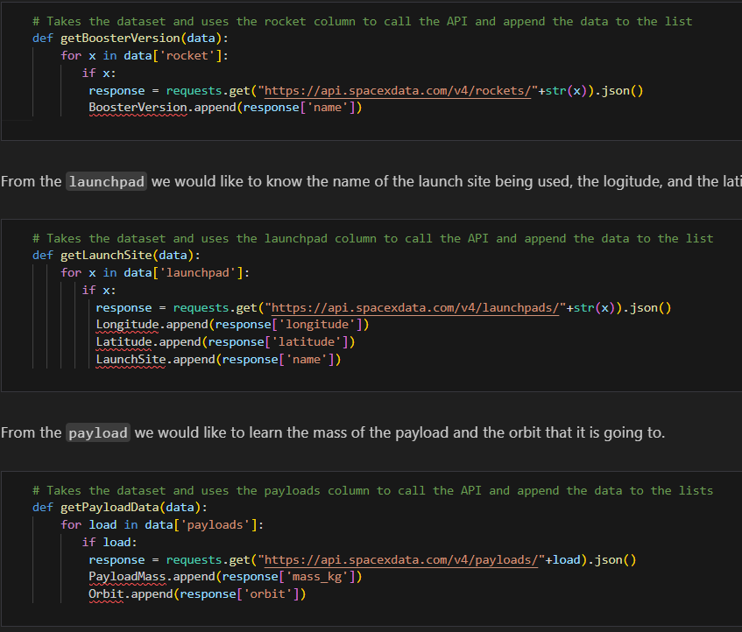
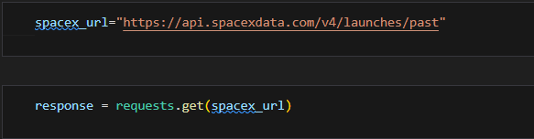
Data Collection – SpaceX API continued
Supporting GitHub hosted notebook: Coursera_Capstone/01_SpaceX_Data_Collection_API-SK.ipynb at main · skennedybda/Coursera_Capstone (github.com)

Slide 9
Data Collection - Scraping
Request Data from target Wikipedia webpage
Create a BeautifulSoup object from the response
Create column names into a list by extracting the response’s HTML Table headers
Collect data from parsing HTML tables in response
Create dictionary from parsed data
Create dataframe from this dictionary
Export Data to CSV file
Supporting GitHub hosted notebook: Coursera_Capstone/02_SpaceX_Web_Scraping-SK.ipynb at main · skennedybda/Coursera_Capstone (github.com)

Slide 10
Data Wrangling
Explore data and determine data labels
Calculate:
Number of launches per site
Number and occurrences of orbit
Number and occurrence of mission outcomes for each orbit types
Create landing outcome column by classifying bad outcomes (binary, success = 1, fail = 0)
Supporting GitHub hosted notebook: Coursera_Capstone/03_SpaceX_Data_Wrangling-SK.ipynb at main · skennedybda/Coursera_Capstone (github.com)

Slide 11
EDA with Data Visualization
Created charts to explore insights for the below relationships in the data analyzed:
Flight Number vs. Payload
Flight Number vs. Launch Site
Payload Mass vs. Launch Site
Payload Mass vs. Orbit Type
Types of charts used included scatter plots and line charts for trend/correlation analysis. Also utilized bar charts to show relationships between categorized attributes and measured values
Supporting GitHub hosted notebook: Coursera_Capstone/05_SpaceX_EDA_Data_Visualization-SK.ipynb at main · skennedybda/Coursera_Capstone (github.com)

Slide 12
EDA with SQL
Queries
Return list of launch sites named (unique, no duplicates)
Return five records where their launch site begins with ‘CCS’
Return the total sum of payload mass carried by boosters launched by NASA (CRS)
Return the average payload mass carried by booster version F9 v1.1
Return the date of the first successful landing on a ground pad
Return the list of boosters that had success landing with a drone ship and had a payload mass between 4,000 – 6,000 kg
Return the total number of launches by mission outcome
Return list of Booster versions that carried the largest payload mass
Return list of failed landing outcomes via drone ship, including their booster version, launch site, month and year of event
Return Count of landing outcomes between 04 June 2010 and 20 March 2020 in descending order
Supporting GitHub hosted notebook: Coursera_Capstone/04_SpaceX_EDA_SQL-SK.ipynb at main · skennedybda/Coursera_Capstone (github.com)

Slide 13
Build an Interactive Map with Folium
Added markers to indicate the locations of the launch sites. Utilized popup labels, red circles to identify target launch sites
Added colored markers for successful (green) and unsuccessful (red) launches for each site. This assisted in visualizing the success rate at each launch site reviewed
Also added in colored lines to visualize distance between launch site CCAFS SLC-40 and nearest highway, railway, city, and coastline proximities
Supporting GitHub hosted notebook: Coursera_Capstone/06_SpaceX_Interactive_Visual_Analytics_Folium-SK.ipynb at main · skennedybda/Coursera_Capstone (github.com)

Slide 14
Build a Dashboard with Plotly Dash
Created an interactive Pie and Scatter Plot dashboard.
Visuals via the Pie chart can be seen for all sites and individually from a drop-down selection.
Visuals via the Scatter Plot chart can be seen for all payload sizes or customized for a range via a slider scale.
These visuals show the success rate of launch outcomes for sites, among peers and individually. They also show the launch outcomes per site based on payload size.
Supporting GitHub hosted Python file: Coursera_Capstone/07_SpaceX_Interactive_Visual_Analytics_Plotly-SK.py at main · skennedybda/Coursera_Capstone (github.com)

Slide 15
Predictive Analysis (Classification)
Created a NumPy array from the dataset’s Class column
Standardized the dataset with StandardScaler to fit and transform the data
Split the data to create a Training data set
Created and Applied a GridSearchCV object on four different classification methods.
Logistic regression, Support Vect Machine (SVC), Decision Tree, and K-Nearest Neighbor
Calculated the accuracy of each model on using the Training data
Accessed the confusion matric of all models
Identified the best model by analyzing the calculated Jaccard score, F1 score, and Accuracy statistics
Supporting GitHub hosted notebook: Coursera_Capstone/08_SpaceX_Predictive_Analytics.ipynb-SK.ipynb at main · skennedybda/Coursera_Capstone (github.com)

Slide 16
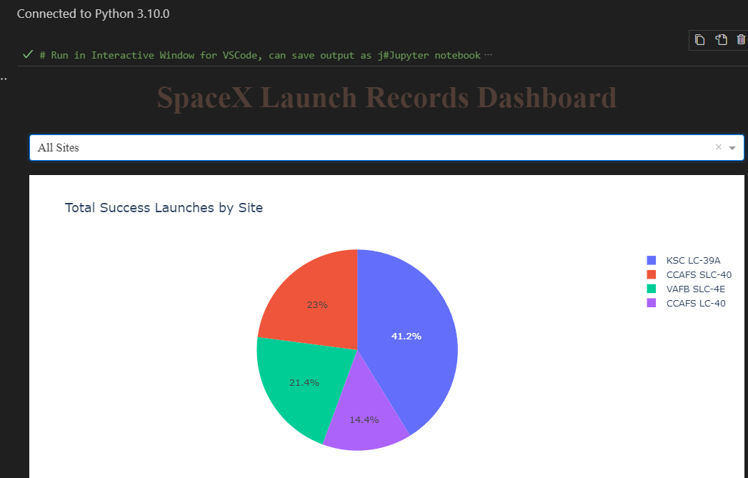
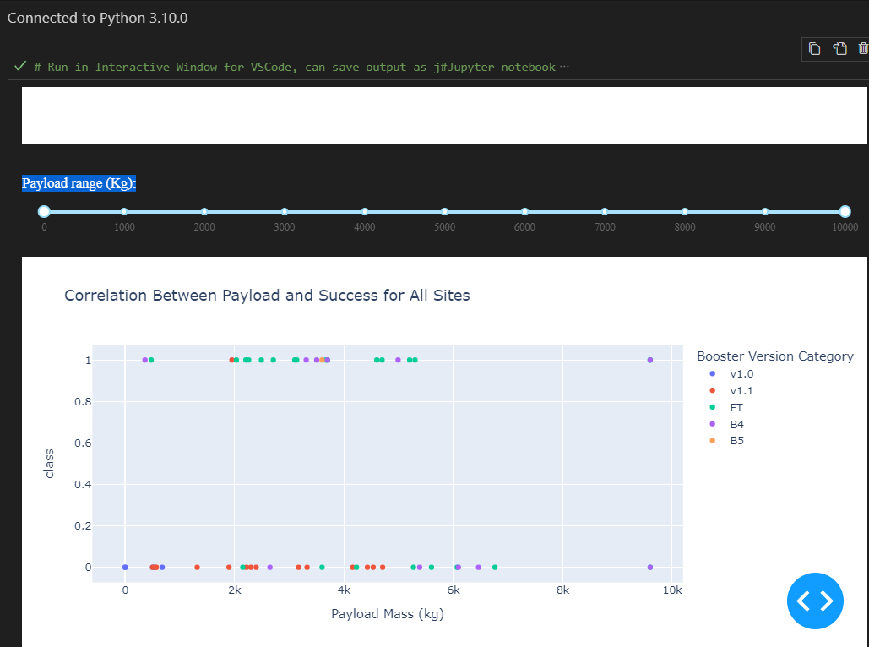
Results
Exploratory data analysis
Success rate of rocket launches improved with more attempts, even with higher payloads
Launch site KSC LC-39A had the highest success rate among its peers
Orbit types ES-LI, GEO, HEO, and SSO most successful with 100% success rate.
But these require additional launch data and analysis due to Orbit types ISS and GTO being the most widely used in launch attempts limiting launches for the above mentioned
Predictive analysis results
Decision Tree model was the best predictive model for the dataset utilized
All predictive models analyzed returned the same level of accuracy, positively at 83.33%
Interactive analytics demo in screenshots

Slide 17

Section 2

Slide 18
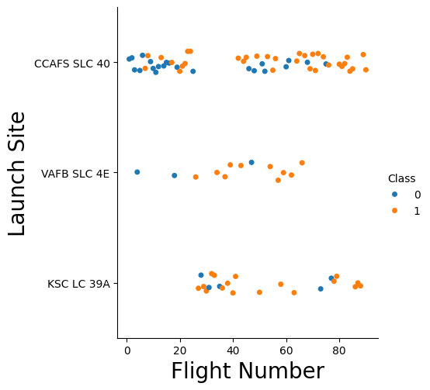
Flight Number vs. Launch Site
It was found that generally more successful launches were seen when launch sites had higher numbers of flights
Additionally, it is observed that a higher concentration of successful launches occurred during the later end of launch attempts per site.
In this chart Success = 1 via Class

Slide 19
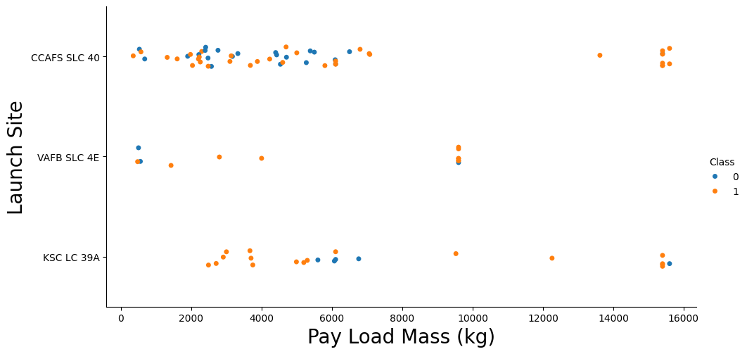
Payload vs. Launch Site
On observation, higher payload launches resulted in a higher success rate.
A majority of launches greater than 9,000 kg were successful.
Launch site VAFB SLC 4E did not launch a payload greater than 10,000 kg, suggesting a capacity limit for the site
In this chart Success = 1 via Class

Slide 20
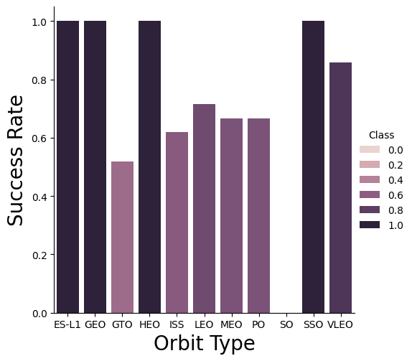
Success Rate vs. Orbit Type
Success Rate of 100% included Orbit Types of ES-L1, GEO, HEO, SSO
Success Rate of 50 – 90% included GTO, ISS, LEO, MEO, PO
Orbit Type of SO did not have a successful launch

Slide 21
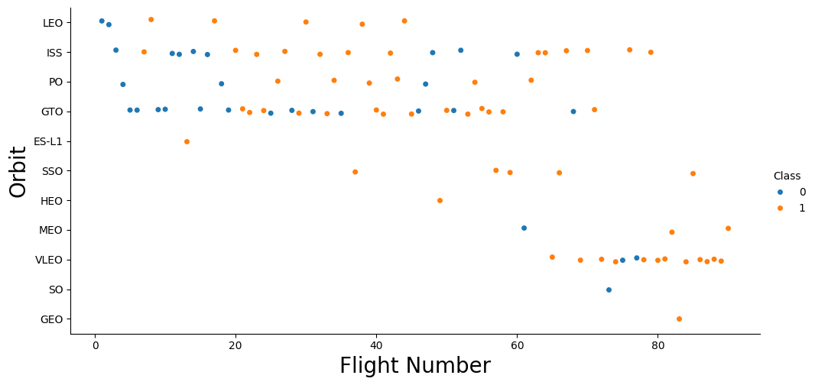
Flight Number vs. Orbit Type
Viewing orbit type launch outcome by flight number shows that some orbit types were not tested as thoroughly as others.
This is particularly seen in orbit types GEO and SO where each only had one launch attempt. This leads belief that there is not enough evidence to consider either orbit types as successful / inferior to other orbit types respectfully.
Majority of launches utilized orbit types IS or GTO
In this chart Success = 1 via Class

Slide 22
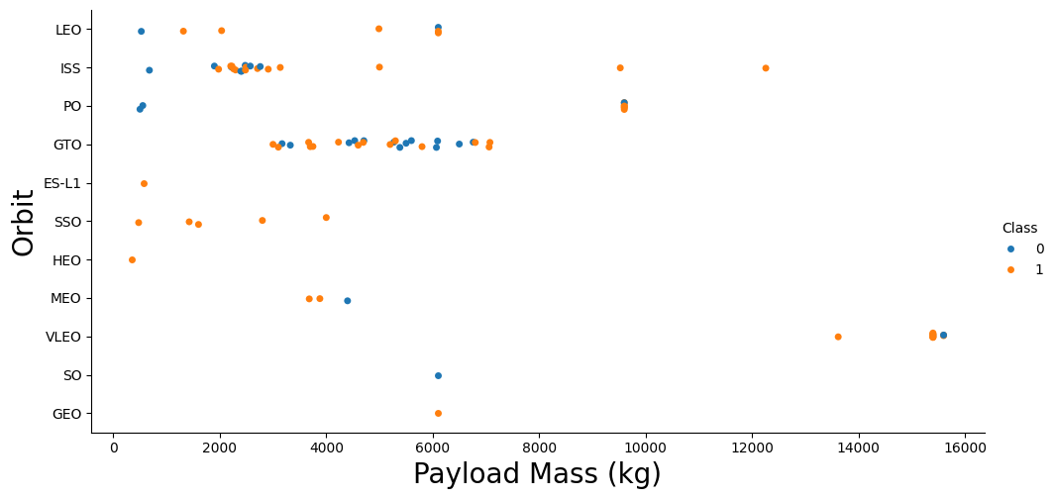
Payload vs. Orbit Type
Orbit Type VLEO was exclusively used for the highest payload launch attempts (above 13,000 kg)
Majority of launch attempts utilized ISS or GTO, with observance that launch attempts concentrated within the 2,000 – 7,000 kg payload range. This supports the popularity, or prior establishment, of orbit types of ISS and GTO.
It is interesting that while these orbit types had failed / no launch attempts at lower payload under 2,000 kg, orbit types with success at that level ES-L1, SSO, HEO were not utilized in higher payload launch attempts
In this chart Success = 1 via Class

Slide 23
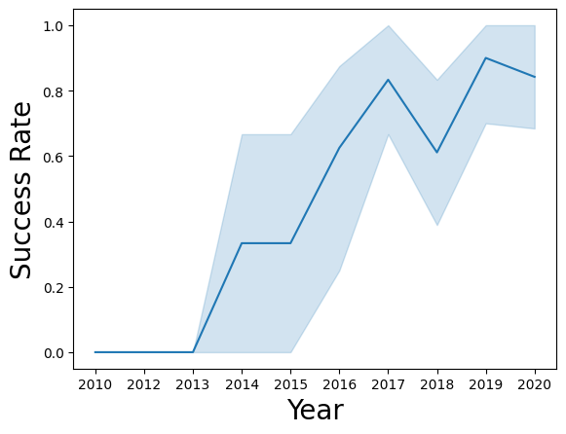
Launch Success Yearly Trend
The success rate of launch attempts is positive overall from year 2013 to 2020
There was a sharp decline in performance between 2017 to 2018 but this was followed with an equal recovery in the following year

Slide 24
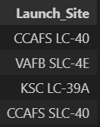
All Launch Site Names
Query: %sql SELECT DISTINCT(LAUNCH_SITE) FROM SPACEXTABLE
Logic: Return a unique list of the different launch sites from the data set
Alternatively, this result can also be achieved with the below query:
%sql SELECT LAUNCH_SITE FROM SPACEXTABLE GROUP BY LAUNCH_SITE

Slide 25
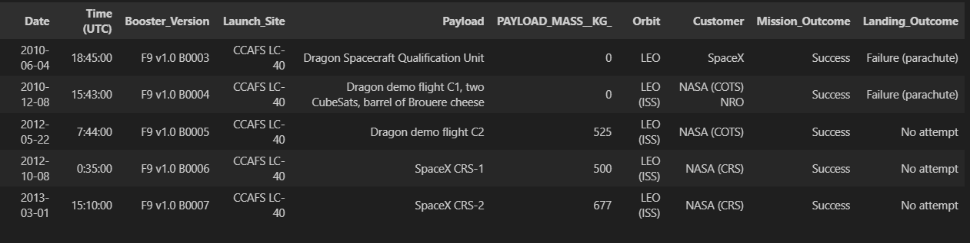
Launch Site Names Begin with 'CCA'
Query: %sql SELECT * FROM SPACEXTABLE WHERE LAUNCH_SITE LIKE ('CCA%') LIMIT 5
Logic: Show up to five transactions that are have launch site name that begins with ‘CCA’

Slide 26
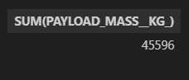
Total Payload Mass
Query: %sql SELECT SUM(PAYLOAD_MASS__KG_) FROM SPACEXTABLE WHERE CUSTOMER = 'NASA (CRS)' AND Booster_Version IS NOT NULL AND Booster_Version != ‘’
Logic: Show the total amount of payload mass carried by launches using boosters from NASA (CRS). The additional where parameters on Booster_Version ensures that there is a booster assigned to the launches included in the summed total.

Slide 27
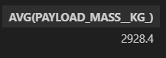
Average Payload Mass by F9 v1.1
Query: %sql SELECT AVG(PAYLOAD_MASS__KG_) FROM SPACEXTABLE WHERE BOOSTER_VERSION = 'F9 v1.1’
Logic: Show the average payload mass for launches that used booster version ‘F9 v1.1’

Slide 28

First Successful Ground Landing Date
Query: %sql SELECT MIN(DATE) FROM SPACEXTABLE WHERE MISSION_OUTCOME = 'Success' AND LANDING_OUTCOME LIKE '%ground pad%’
Logic: Show the first date of a successful mission outcome where the landing outcome was a Ground pad type landing

Slide 29
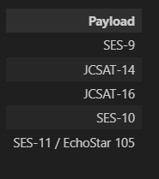
Successful Drone Ship Landing with Payload between 4000 and 6000
List the names of boosters which have successfully landed on drone ship and had payload mass greater than 4000 but less than 6000
Present your query result with a short explanation here
%sql SELECT PAYLOAD FROM SPACEXTABLE WHERE MISSION_OUTCOME = 'Success' AND LANDING_OUTCOME LIKE '%drone ship%' AND PAYLOAD_MASS__KG_ BETWEEN 4000 AND 6000

Slide 30
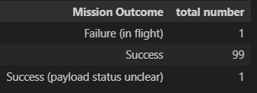
Total Number of Successful and Failure Mission Outcomes
Calculate the total number of successful and failure mission outcomes
Present your query result with a short explanation here
%sql SELECT MISSION_OUTCOME, COUNT(*) as 'total number' FROM SPACEXTABLE GROUP BY MISSION_OUTCOME

Slide 31
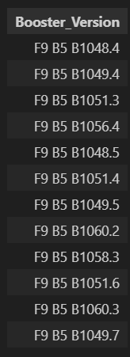
Boosters that Carried Maximum Payload
Query: %sql SELECT BOOSTER_VERSION FROM SPACEXTABLE WHERE PAYLOAD_MASS__KG_ = (SELECT MAX(PAYLOAD_MASS__KG_) FROM SPACEXTABLE)
Logic: Show the booster versions that were used to carry the largest payload mass recorded in the supporting dataset

Slide 32
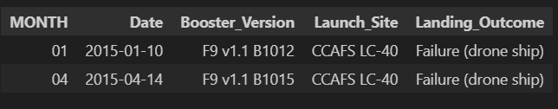
2015 Launch Records
Query: %sql SELECT SUBSTR(Date,6,2) as MONTH, DATE, BOOSTER_VERSION, LAUNCH_SITE, LANDING_OUTCOME FROM SPACEXTABLE WHERE LANDING_OUTCOME = 'Failure (drone ship)' and SUBSTR(Date,0,5)='2015’
Logic: Output the launches where the landing outcome was a failure by drone ship. In the results presented, show the month, full date, booster version used, launch site and landing outcome type

Slide 33
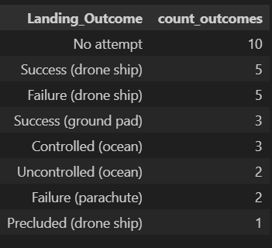
Rank Landing Outcomes Between 2010-06-04 and 2017-03-20
Query: %sql SELECT LANDING_OUTCOME, COUNT(*) as count_outcomes FROM SPACEXTABLE WHERE DATE BETWEEN '2010-06-04' and '2017-03-20' GROUP BY LANDING_OUTCOME ORDER BY count_outcomes DESC
Logic: Output the amount of launch attempts by each type of landing outcome, between the dates of 04 June 2010 and 20 March 2017, ordering / sorting the result to view the landing outcomes by descending order in count value.

Slide 34

Section 3

Slide 35
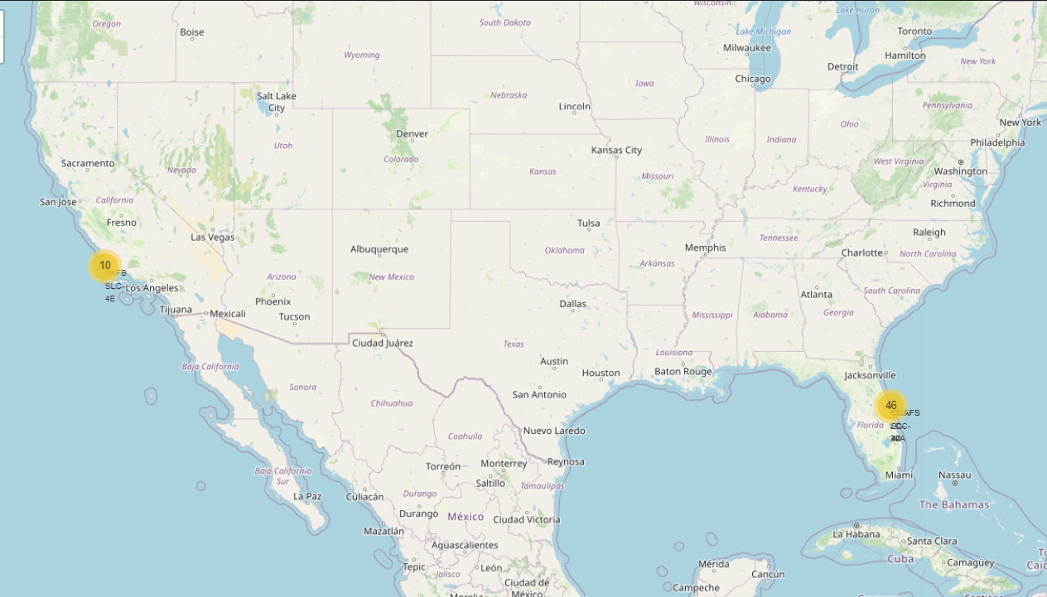
Launch Sites - Locations
Launch sites populated both sides of USA, with one on the California coast and the remaining three in Florida.
From the attempted launches, a majority were conducted closer to the equator via the launch site CCAFS LC-40.

Slide 36
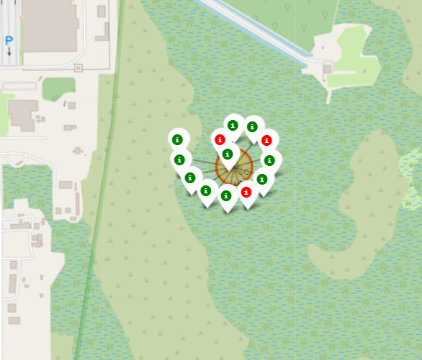
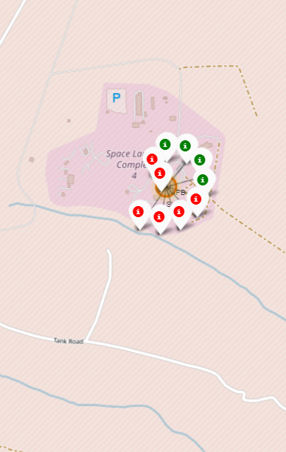
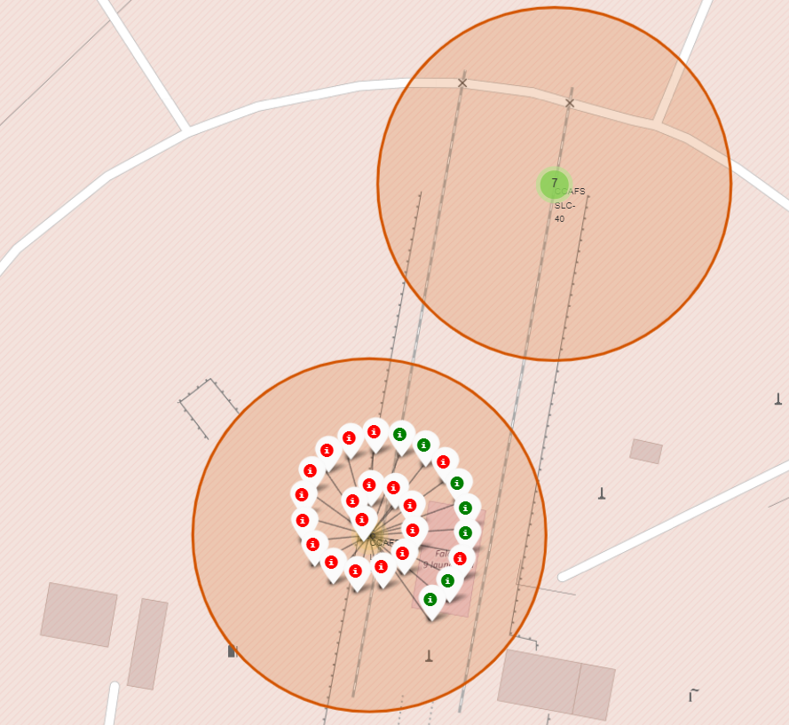
Launch Outcomes
On the map per site, launch sites are identified by red map circles.
Launch outcomes are labelled green = successful, red = failed

Slide 37
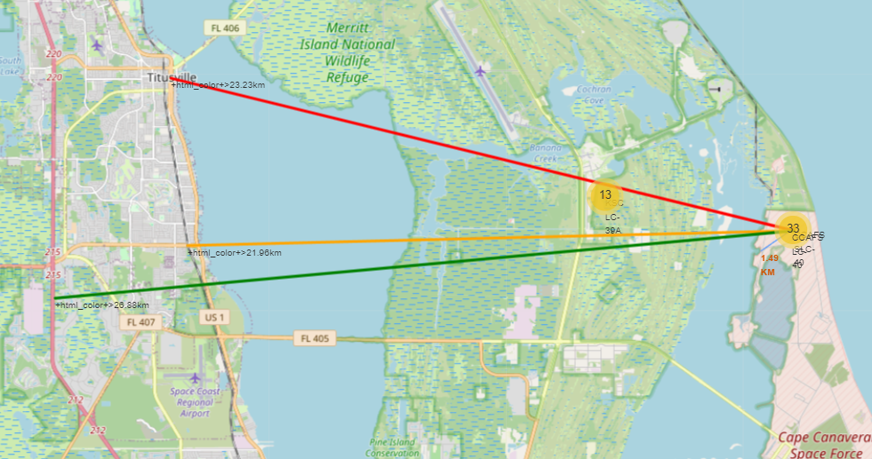
Launch Site Distance to Proximities
CCAFS SLC-40
1.49 km from nearest coastline (blue)
21.96 km from nearest railway (gold)
23.23 km from nearest city (red)
26.88 km from nearest highway (green)

Slide 38

Section 4

Slide 39
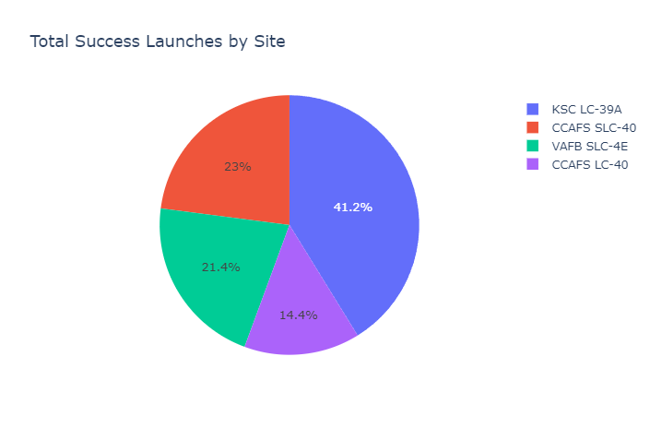
Breakdown of Launch Success per Site
KSC LC-39A had the highest proportion of successful launches among its peers
The site recorded 41.2% of successful launches across all launch sites

Slide 40
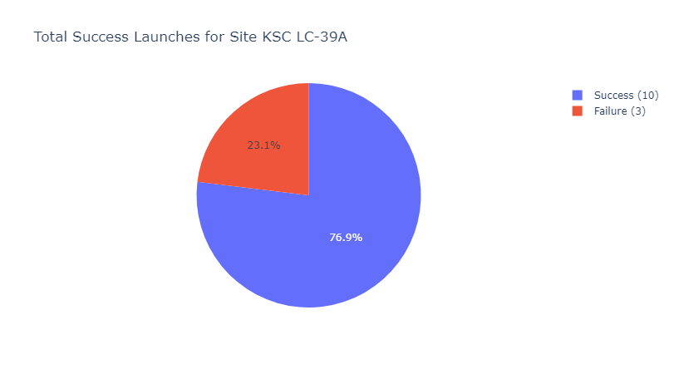
Success Ratio of Launch Site KSC LC-39A
This chart displays the success ratio of site KSC LC-39A over all its launch attempts.
With the legend presenting Successful launches totaling 10 out of the total 13 launches executed.

Slide 41
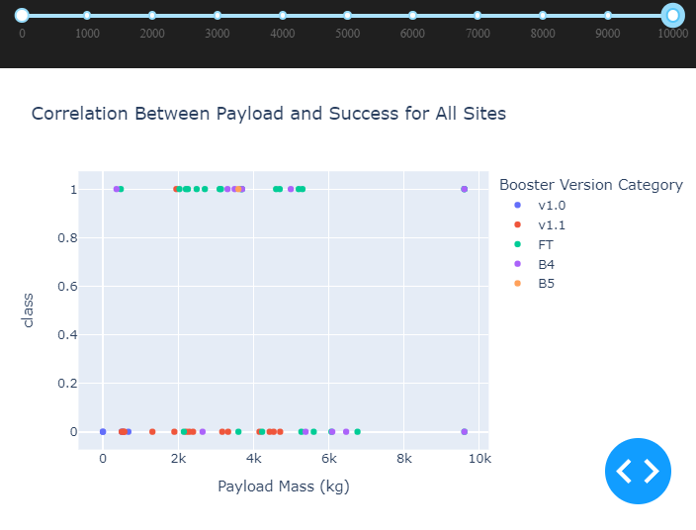
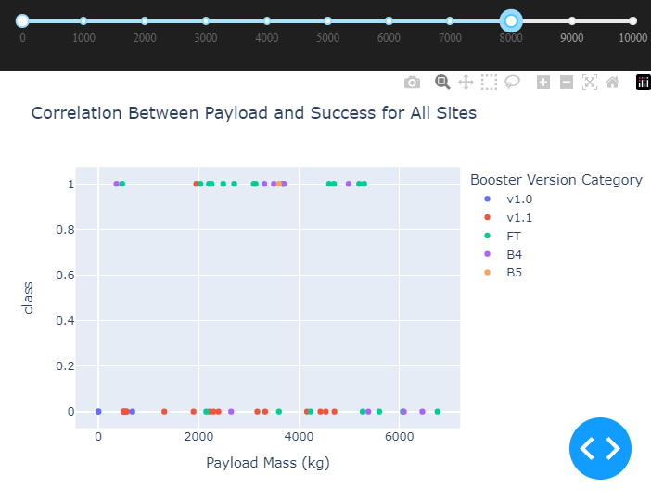
Effect of Payloads on Launch Outcomes
Looking deeper into the scale of payload and its affect on launch outcomes, we can see an observance that smaller payloads have more successful launches
In these screenshots, successful launches are represented by class = 1

Slide 42

Section 5

Slide 43
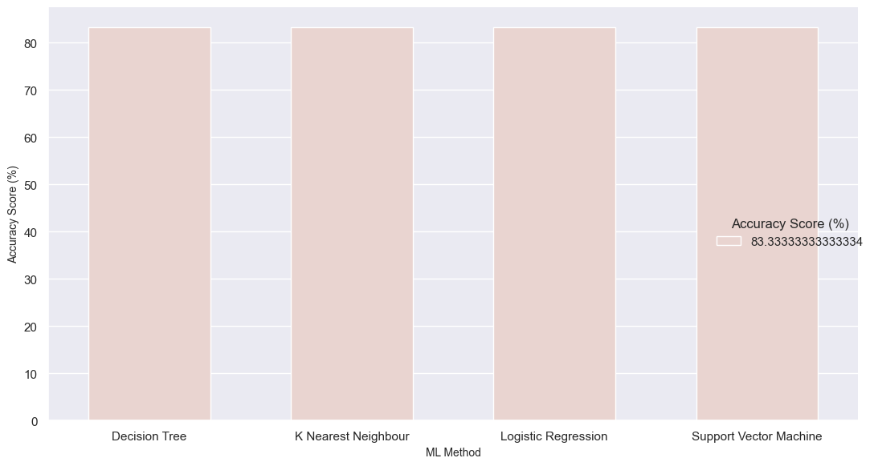
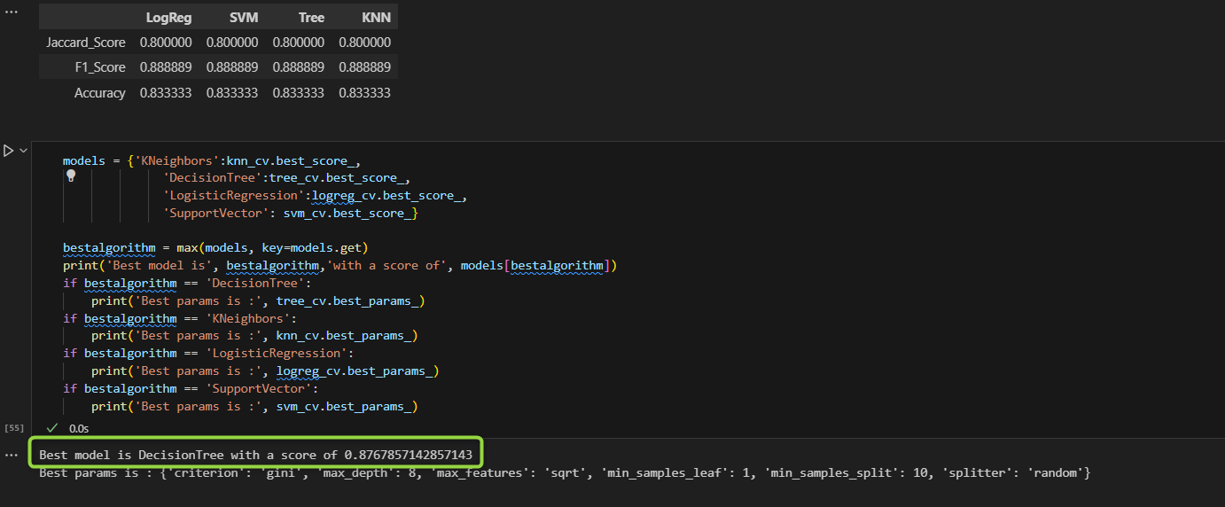
Classification Accuracy
It was found that each classification model calculated with the same accuracy score of 83.33%
This is likely due to the limited size of the data set used for the models
The best model identified was the Decision Tree model

Slide 44

Confusion Matrix
Best performing model was the Decision Tree algorithm
A confusion matrix summarizes the performance of a classification algorithm’s output, where correct and incorrect (false) predictions are identified.
There is are false positives, which is not ideal. However, the accuracy of this model matches the other models tested.
Confusion Matrix Outputs:
9 True positive, 5 True negative, 1 False positive, 3 False Negatives
Precision = TP / (TP + FP) = 12 / (12 + 3) = 80%
Recall = TP / (TP + FN) = 12 / (12 + 0) = 100%
F1 Score = (2 * Precision * Recall) / (Precision + Recall) (2 * 0.80 * 1.00) / (0.80 + 1.00) = 88.88%
Accuracy = (TP + TN) / (TP + TN + FP + FN) = (12 + 3) / (12 + 3 + 3 + 0) = 83.33%

Slide 45
Conclusions
This project provides interesting initial insights into pursuit of predicting launch outcomes
This insight should take the below factors into consideration:
Data set was limited; a larger dataset would allow there to be more differentiation in accuracy performance for the models’ prediction training.
There are likely additional factors and characteristics that influenced most flights to utilize the same launch site and two orbit types.
A qualitative exploration of this could be warranted to expose any bias that could affect the data being accepted for appropriate training of the models.

Slide 46

Appendix
For reference, I made effort to utilize a local environment for the coding files utilized in this Capstone project. Using VS Code as the IDE, I set up the latest Python interpreter version (3.10) and installed the latest package versions and their dependencies
This disrupted some import code lines for a few of the labs, requiring some research to rebuild the code and confirm that the labs’ directional integrity were not disrupted by my output after committing to such changes
Special thanks to the authors, supporting professionals and peers that have provided feedback and improvements to this course
Thank you!

Slide 47


